Slide 1


WEEK 3
SPRINT 1
PL6
REQ

Slide 2


about us.

Slide 3
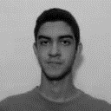
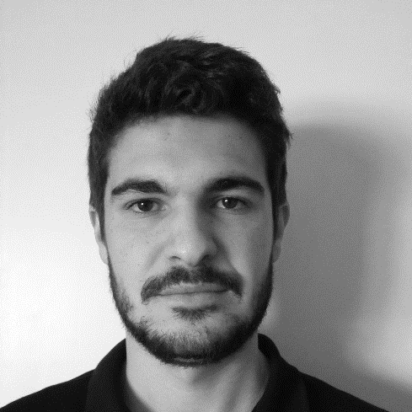
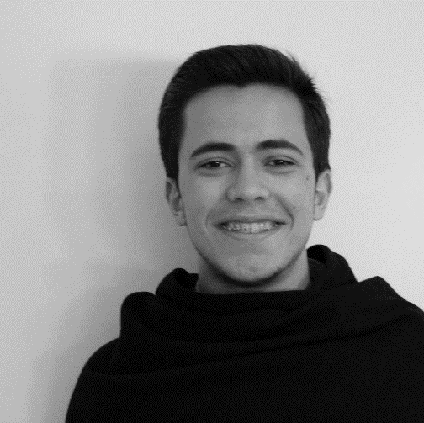
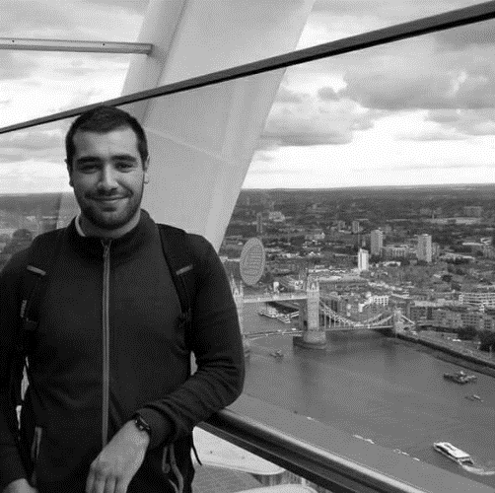
req.
Alexandre
Emanuel
Marco
Paulo

Slide 4
week tasks.
 | TASK #1 | TASK #2 | TASK #3 | TASK #4
TASK | Do gantt diagram | Meeting with the client | Prepare the weekly presentation | Internal meeting
OWNER | Alexandre | Paulo, Emanuel | Marco | Alexandre, Emanuel, Marco, Paulo
GOAL EFFORT | 1 H | 1 H | 1 H | 1 H 30
EFFECTIVE EFFORT | 1 H 35 | 0 H 55 | 1 H 10 | 1 H 45
STATUS | COMPLETED | COMPLETED | COMPLETED | COMPLETED

Slide 5
week tasks.
 | TASK #5 | TASK #6 | TASK #7 | TASK #8
TASK | Upgrade the requirements document | Internal Meeting Minute | 1 Meeting with cliente Minute | 2 Meeting with cliente Minute
OWNER | Paulo | Marco | Alexandre | Emanuel
GOAL EFFORT | 1 H | 0 H 30 | 0 H 30 | 0 H 30
EFFECTIVE EFFORT | - | 0 H 45 | - | -
STATUS | IN PROGRESS | COMPLETED | IN PROGRESS | IN PROGRESS

Slide 6
planned tasks.
 | TASK #1 | TASK #2 | TASK #3
TASK | Finish Mockups | Meeting with the client | Making of requirement document
OWNER | Team | Team | Team
GOAL EFFORT | 4 H | 1 H | 8 H
STATUS | NEW | NEW | NEW

